Slide 1
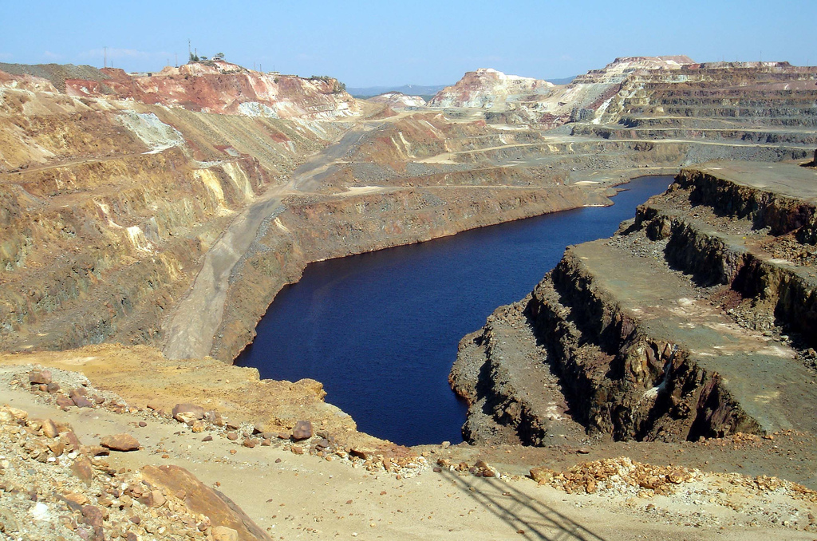
Accounting Conventions and Applications
Year 11 Accounting 2023

Slide 2
For each of the following situations state which accounting assumption/convention or principle is being complied with or breached

Slide 3
Rio Tinto operates in many countries and trades in many different currencies. It’s annual report shows it’s financial results in terms of Australian Dollars.

Slide 4
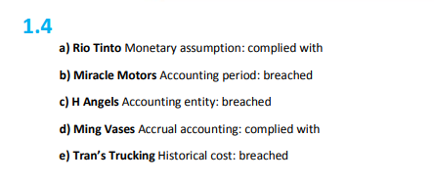

Slide 5
Miracle Motors produces it’s financial reports at the end of the financial year 30 June 2023 and once in between, usually in November, December or January, when the owner has time to do it.

Slide 6


Slide 7
H. Angels has included his motor cycle as a business asset so that he can write off it’s costs as a business expense. The motorcycle is not used in the business.

Slide 9
At the end of each year, Tran’s Trucking makes an estimate of what it could get for each of it’s trucks if it sold them and re-values them accordingly

